Slide 1


Simply fly

Slide 2

John’s problem

Slide 3

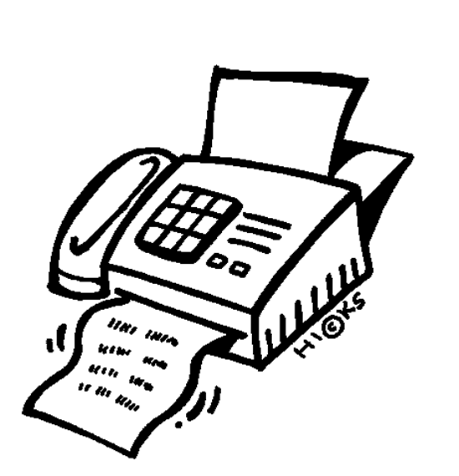


Simplifying processes

Slide 4
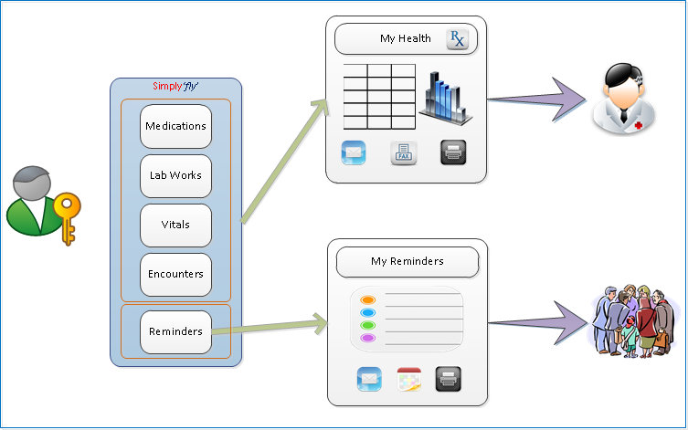
Simply fly – the solution

Slide 5
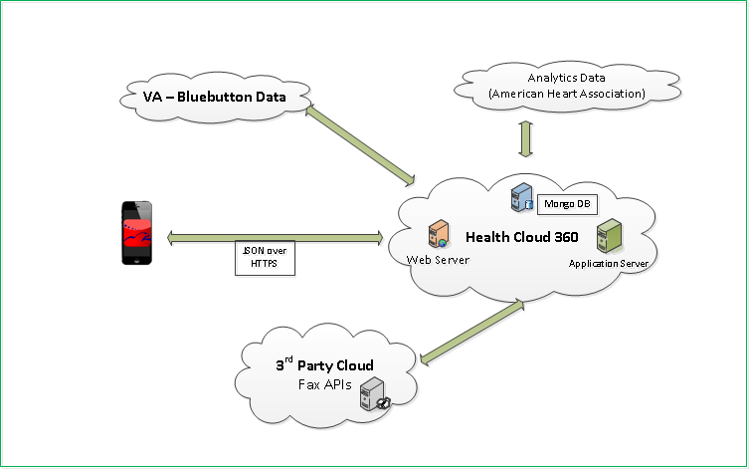
Simply fly – the Architecture

Slide 6
Simply fly – Demo
Demo

Slide 7
Thank you

